Slide 1
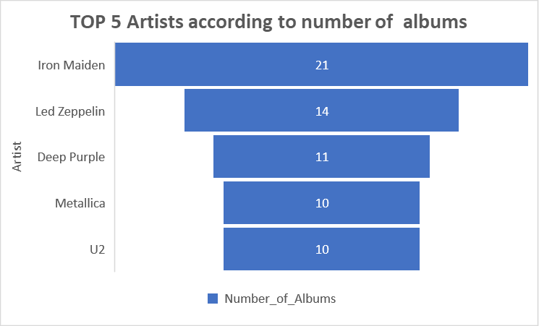
Who are the top 5 artist in terms of number of albums?
We can see Iron Maiden has the largest amount of albums of any artist, no other artist even close to the amount.

Slide 2
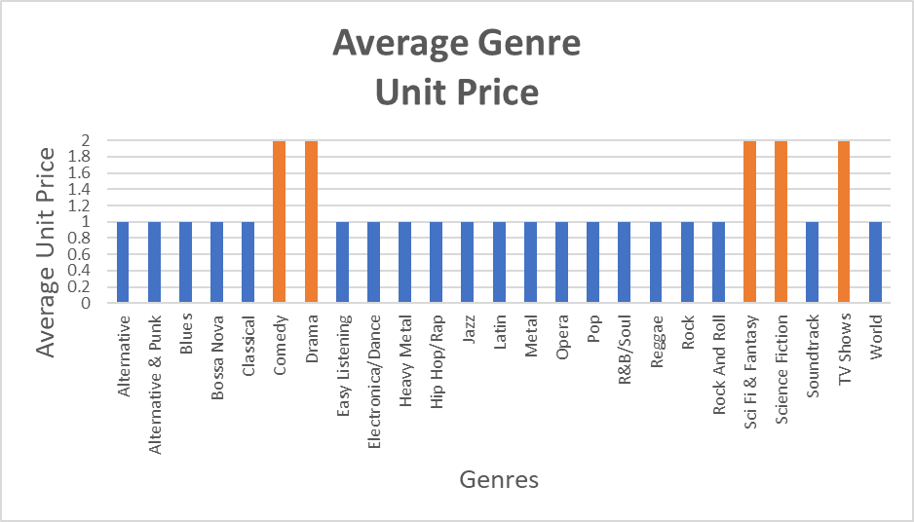
What are the genres that have average track price 1$ or over?
We can see in the graph the genres that have average unit price per track 1$ or over in orange color and they are more expensive than the rest of the genres.

Slide 3
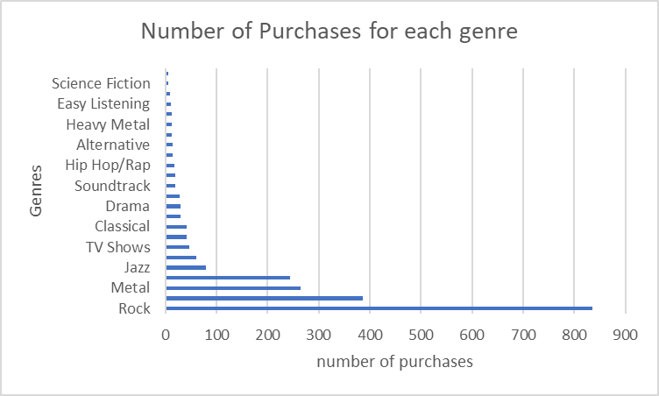
What is the number of purchases for each genre?
We can see that Rock have the largest number of purchases and it is more than double the number of purchases of Metal.

Slide 4
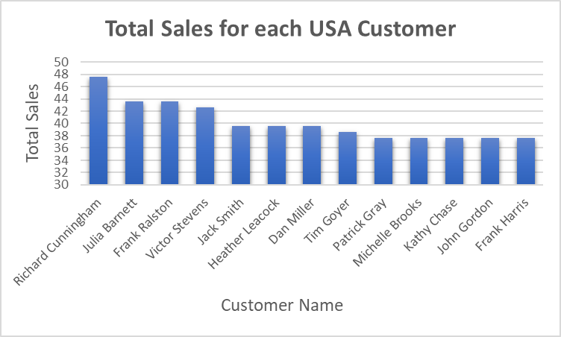
How much USA customer spent?
We can see all of the USA Customers in this graph and how much they spent, Mr. Richard Cunningham is highest spending custmer in USA he spent 47.62$.

